Slide 1


Slide 2

Multiple Sclerosis
Incidence
Severity
Wide Range of Disability
Permanent Lost Function
Incurable
Most common inflammatory neurological disease in young adults
Leading cause of non-traumatic disability in young adults

Slide 3
Unmet Need
Psychological
Neurological
Financial
Uncertainty
Frustration
Pain and Discomfort
Permanent Morbidity
Progression
$63,000 - $103,000 per year

Slide 4

Problem: Treatment Uncertainty

Slide 5
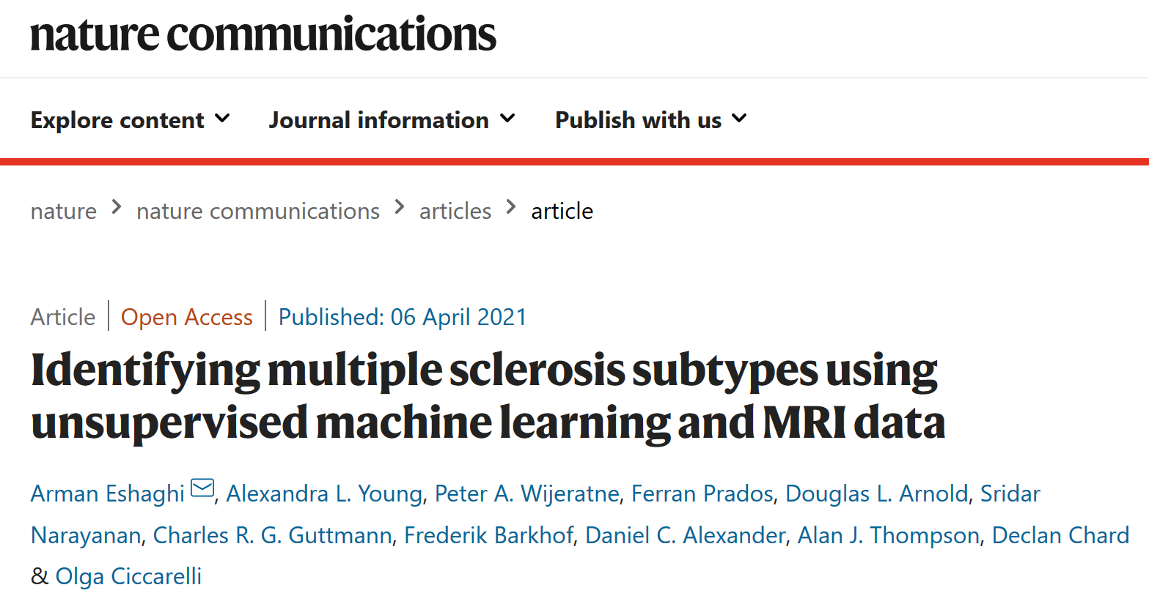
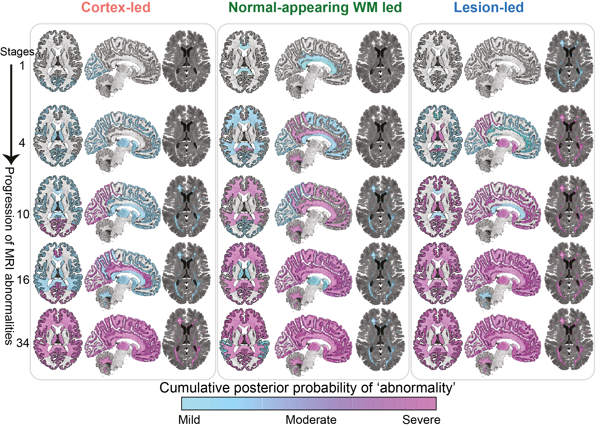
Solution: Treatment Targeting
Peer-reviewed basic science

Slide 6
Technology Roadmap
Applying Machine Learning Innovation to Neurological Image Processing
Pharmacuetical Clinical Trials
Other Neurological Conditions (eg. A/D)
MS treatment providers are keen to invest in analysis of their treatments’ efficacy
The image processing techniques and tools are applicable to other neurological conditions for which treatments are just emerging (eg. Alzheimers, Dementia)
Saas Treatment Targeting Diagnostic
Neurologists, MS patients and funders are keen to reduce the uncertainty in treatment prescribing

Slide 7
Addressable Market
2.8m Multiple Sclerosis Patients Worldwide
World
Europe
2.8m
0.7m
0.2m
0.7m
patients
patients
1.0m
USA
UK
1.0m
0.2m
patients
patients

Slide 8
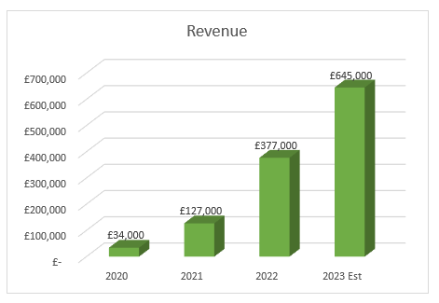
Services
Solid financial underpinning based on ‘starter’ services business
Benefits
Services Business
Market Validation
Data Set Enriching
Neurology Sector Profile
Industry Partnerships
Financial Solvency/Security
Steadily growing revenue and book of business.

Slide 9




Team
Leading experts in medical imaging, neuroscience, and clinical trial research
ARMAN ESHAGHI
FREDERIK BARKOF
GEOFF PARKER
Founder
UCL Senior Research Fellow
Director
UCL Professor and Chair of Neuroradiology
Director
UCL Professor of Healthcare Engineering
DANIEL ALEXANDER
CLAUDIA WHEELER-KINGSHOT
BRUCE LYNN
Director
UCL Professor of Imaging Science
CEO
UCL Royal Society Entrepreneur In Residence
Co-Founder
UCL Professor of Magnetic Resonance Physics

Slide 10





Thank You
Pioneering technology and leading expertise combining to enhance the lives of MS patients and reduce provider costs

